Slide 1
MYESHA-TIARA’S
Directing Portfolio

Slide 2
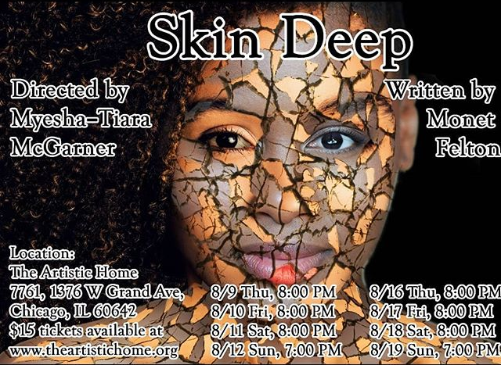
My Director Mission
To focus on the untold and under told stories of the African American experience, slice of life plays, as well as meeting every actor where they are and helping them to elevate their talent and confidence in their abilities. I heavily focus on Meisner technique as well.
(Pictured: Cast pic with actors from Skin Deep. L to R Taylor Elie Talhame, Myesha-Tiara and Tarina Bradshaw. Produced by The Artistic Home)

Slide 3
About Me
Myesha-Tiara hails from Baton Rouge, Louisiana. She found her love for acting at the age of five during an after-school program and hasn't looked back since. After attending the prestigious Baton Rouge Magnet High School, she decided to dedicate herself to her craft and enrolled in Northwestern State University, where in her sophomore year she was fortunate enough to be featured in the Oscar winning film "12 Years a Slave".
While attending NSU Myesha-Tiara also discovered her love for directing and received her Bachelor of Science in Theatre Arts with a concentration in Performance and Directing. After college she performed for regional and touring theatres until she decided to make the big move to the Windy City. ​
At the end of 2019 she started her own 501 c3 non-profit theatre company, Perceptions Theatre, on the Southside of Chicago.​ In 2020 she also started a YouTube Channel: MT's Corner with Myesha-Tiara, that focuses on black acting news, acting advice and her journey in the industry.

Slide 4
2018
Directing Career
(Pictured: Cast, Crew and Playwright of my first reading in Chicago, Some Day. Produced by The Rockwell Theatre Bandits. L to R: Playwright, Asha R. McAllister, Actors, Antwon Funches, Jerluane “Jae” Jenkins, Director, Myesha-Tiara and Actor, Kenny Bell.)

Slide 5
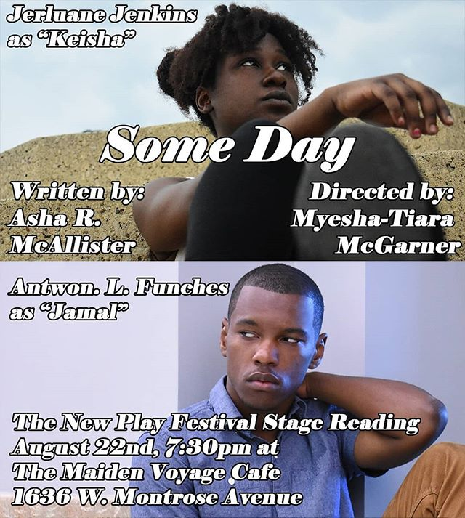
Some Day: (Staged Reading) Focuses on two lifelong friends who find themselves the minority in their PWI and how they cope with this new world.

Slide 6
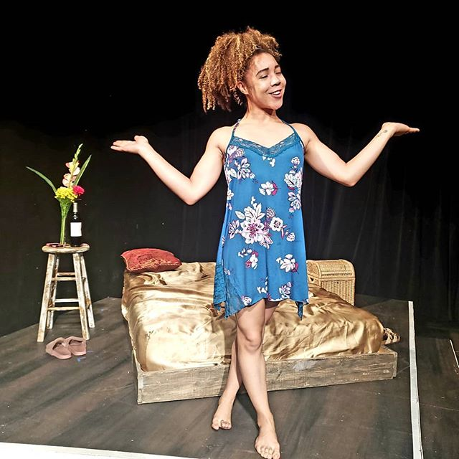
Skin Deep: (One Act Play) Two actor friends meet up for their annual sleepover and things are all going well until one expresses that they booked a national commercial for skin care. It goes from a fun time into a conversation surrounding white washing, biracial and light skin washing characters and how every edgy white actors tries to do an August Wilson monologue for shock value. They must determine if their bond is strong enough to withstand Hollywood.
(Pictured: L to R Tarina Bradshaw and Taylor Elie Talhame)

Slide 7
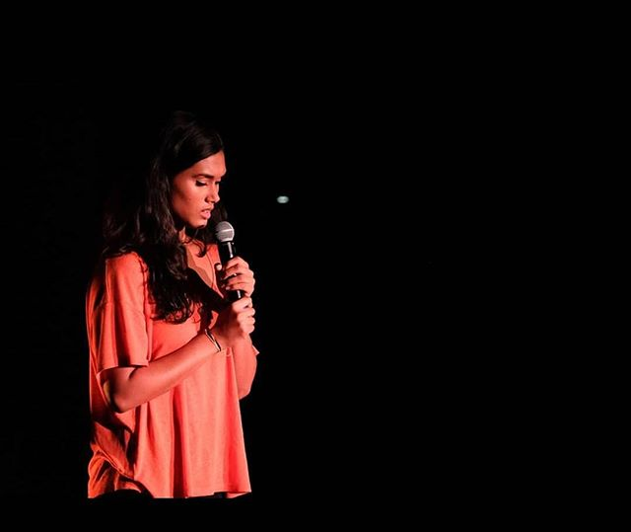
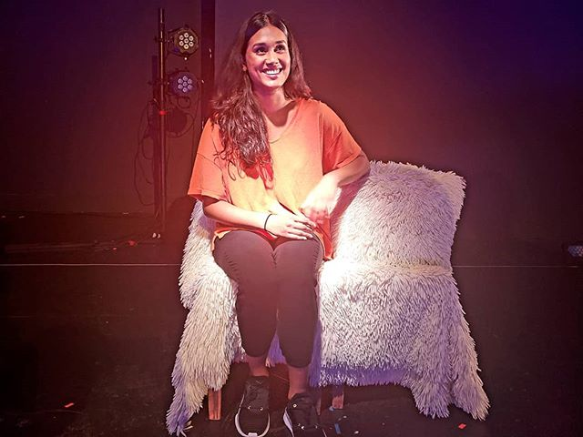
Somewhere in Uptown: (One Woman Show) A woman moves to Uptown, Chicago and must determine if her preconceived notions of that area was all based on her own biases.
(Pictured: Vinithra Rajagopalan. Produced by Collaboraction.)

Slide 8
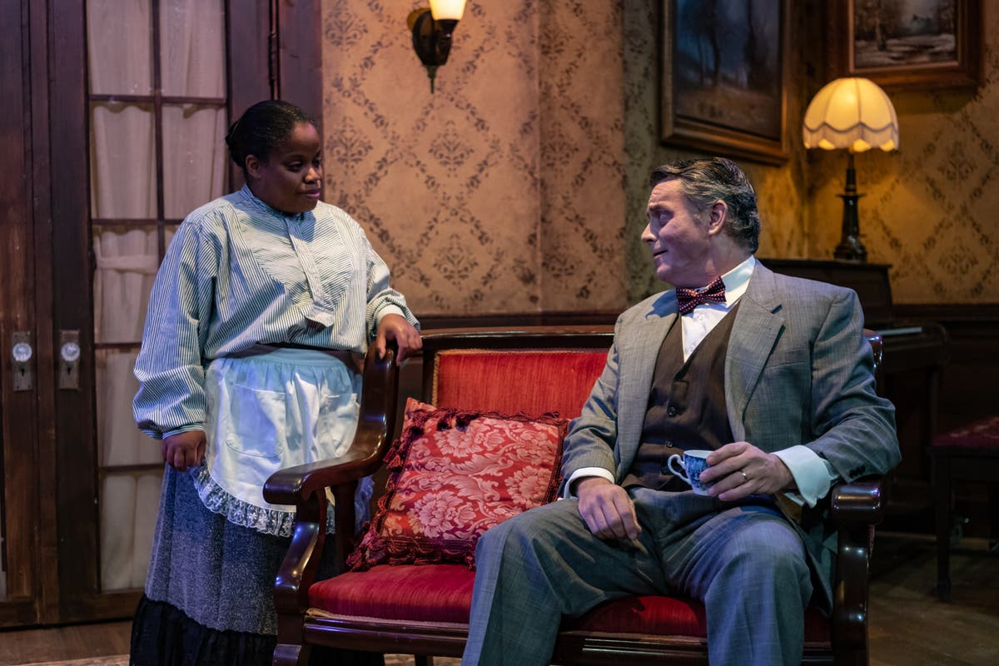
2018: Associate Director Career
The Little Foxes
In 1900, in the cotton country of the deep South, beautiful and brilliant Regina Hubbard Giddens struggles for wealth and freedom within the confines of an early 20th-century society where fathers only considered sons as legal heirs. As a result, thanks to their ruthless tradesman father, her brothers, Benjamin and Oscar are independently wealthy, while she is financially dependent upon her sickly husband, Horace whose severe heart condition has confined him to a sanitarium in Baltimore for several years. Written by Lillian Hellman and Directed by Kristina McCloskey. Produced by Citadel Theatre.

Slide 9
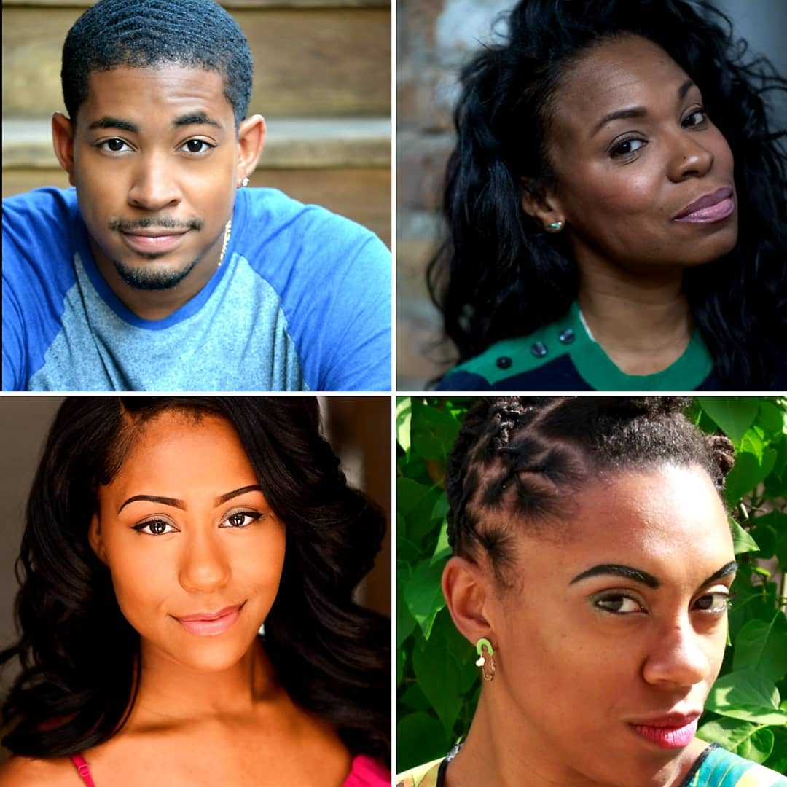
2019: Directing Career
Daises on Harlem’s Doorstep
It's Spring of 1929 in Harlem, a season before the stock market crashed and the world suffered what would be known as the Great Depression. The streets are filled with lights and glitter and for an innocent Daisy, who only wants to find her sister, four very different women show her how to grow in concrete. Written by Sharece Sellem. Produced by Pride Films & Plays
(Staged Reading)
Crabs in a Barrel
After their matriarch dies this family must come to terms with their secrets and resentment for one another. Written by Asha R. McAllister. Produced by The Rockwell Theatre Bandits.
(Staged Reading)
The Bible
On a father’s death bed, he and his son discuss what kept them apart for so many years. Produced by The Artistic Home.
His Hand
A Is For Apron
An overworked mother tells the heart-breaking story on how her son was taken from her and put into foster care. Written by Jaqueline Goldfinger. Produced by Punching Labute at The Lincoln Loft.
(One Woman Show)
Imagine if two women where in purgatory and had to spend that time working in the Otherworld Coin Operated Laundromat then you have "A Is For Apron"! One day all of that changes when a new hire makes her way into purgatory and starts to change up the way things are done. Will the ladies expand their thinking or stick to their old ways? Produced by Red Theater.
(One Act Play)

Slide 10
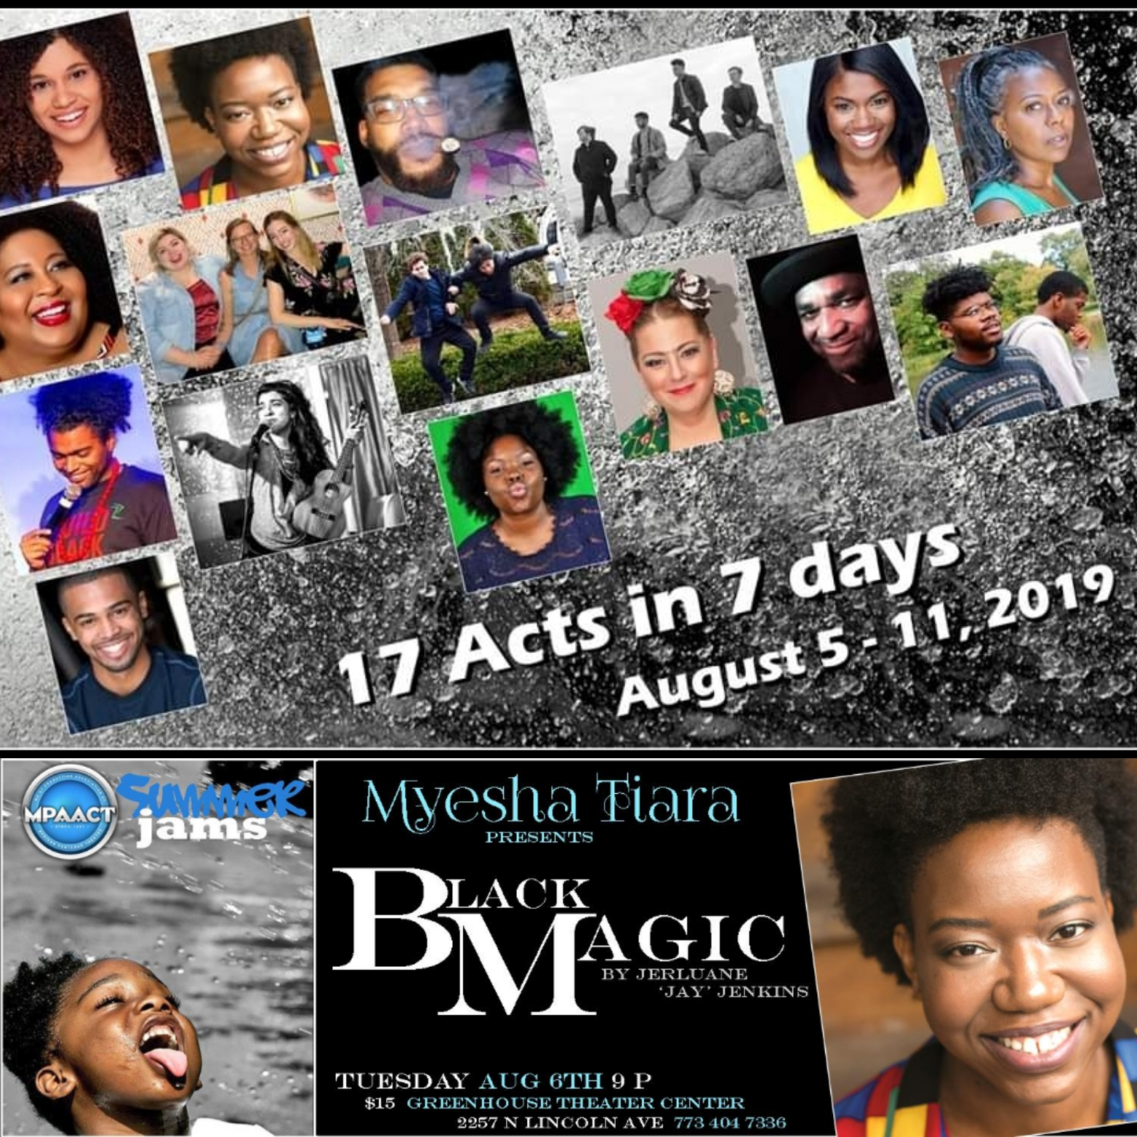
2019: Directing Career
Pampered Pussy
Based on the serial killer, Anthony Sowell, from his victim's perspective. Black Women who happen to be poor and sex workers who only need people to see them as humans for once. Written by Royal Shiree. Produced by The Forge.
(Staged Reading)
Black Magic
Sasha is young, single, college educated and stressed. When she finally gets an opportunity to move out on her own she takes it only to have her brother, Hakeem, move in while he is waiting to start college and then her fly by night sister, Khadijah, moves in but she just needs a place to stay "for a little while". Three is definitely not company and all Sasha has to keep her sane is a package from her late Great Grandmother Tituba, also known as the witch doctor. Will it be her saving grace or her down fall? Black Magic deals with mental illness in people of color and the 5 stages of grief. Written by Jerluane “Jae” Jenkins. Produced by MPAACT.
(One Act Excerpt)

Slide 11
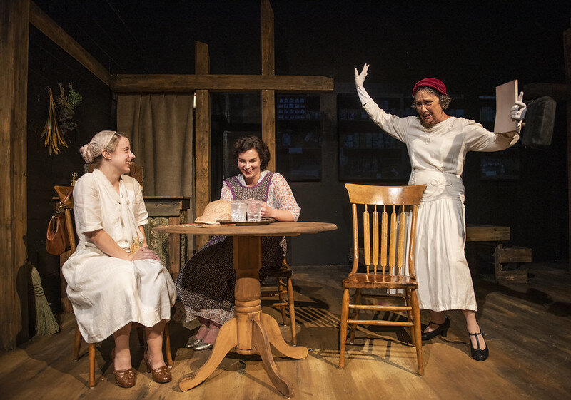
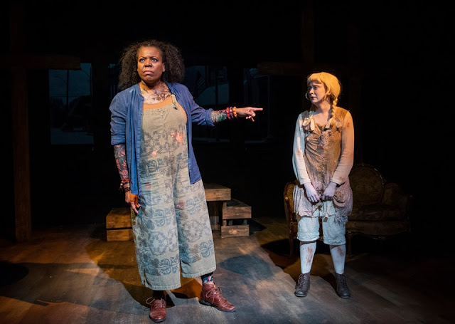
2019: Associate Director Career
Invisible
Imagines a woman in a small Mississippi town in 1925 forced to reconcile her involvement in the rising national Women’s Ku Klux Klan movement with her religious beliefs and sense of decency. Her neighbors have convinced her of the justness of the cause, but the arrival in town of a Chicago newspaper reporter just as their WKKK chapter is gaining momentum, forces Mabel to question her involvement and convictions. Written by Mary Bonnett and Directed by Cecilie Keenan. Produced by Her Story Theater.

Slide 12
2020: Directing Career
Black Magic: World Premiere
After the death of the family matriarch, Tituba, who was a spiritual priestess, Sasha and her siblings are left to sort through her belongings and the complicated feelings left behind. As the oldest, Sasha often handles any challenge thrown her way, while neglecting her own needs. After moving into a her own place it soon gets overrun by her baby brother Hakeem as he embarks on his own journey to college, her rowdy sister Khadija who is always finding herself and her best friend Dee Dee who only wants the best for her.
As feelings of love, grief, ignored realities and revenge boil Sasha desperately looks for a way to connect to her grandmother through the spiritual world as she tries to keep it all together.
(Written by Jerluane “Jae” Jenkins. Produced by Perceptions Theatre.)

Slide 13
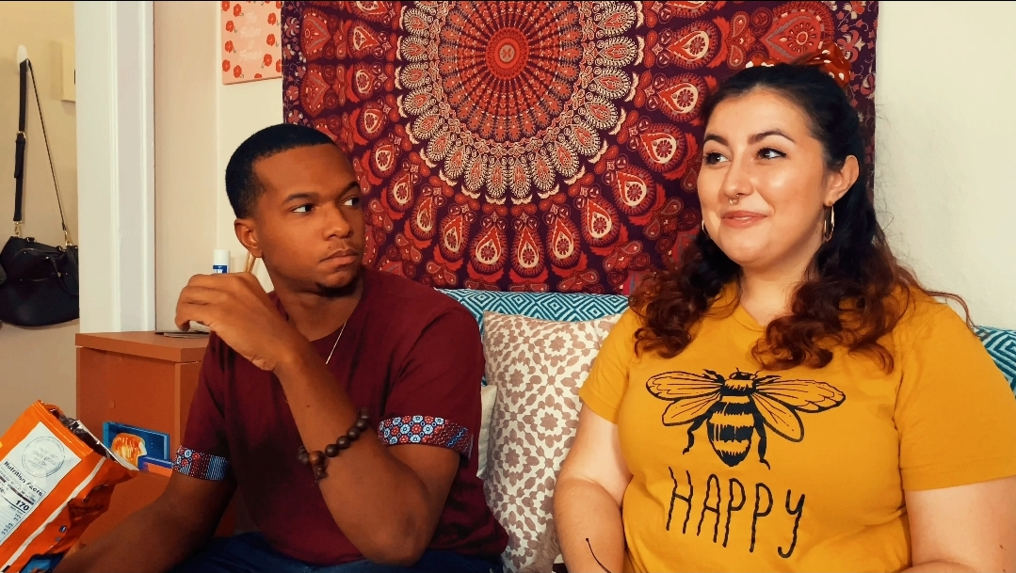
Black Magic: Reviews
-Tanya Kornilovich, Scapi Magazine (Click for full article)
-Mary Barnidge, TotalTheatre.com (Click for full article)
Olivia Lilley, Artistic Director of Prop Thtr
" Perception Theatre’s Black Magic is Joyful and Smart Exploration of Grief.”
" 3 out of 4 Stars. Cinematographer Dareion Shaw's skillful editing captures the ease with which the cast conveys the candor and intimacy of characters immediately recognizable by each of us in Black Magic."
"I enjoyed Black Magic. I loved watching you and your team with experimenting with how to translate a play to a filmic medium. Really cool story, script, performances, images."

Slide 14
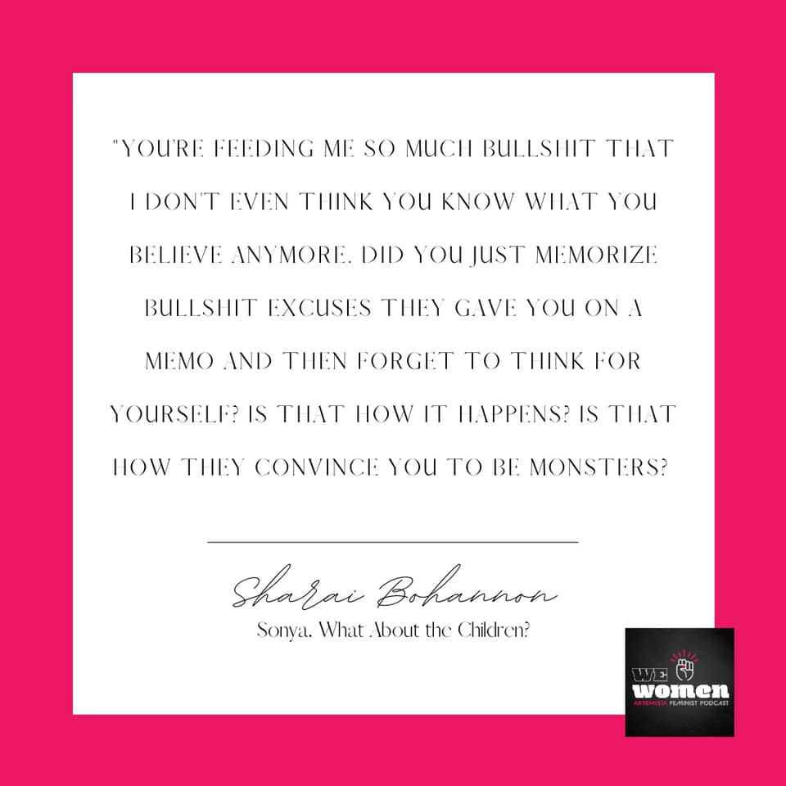
2021: Directing Career
What About The Children
When it comes to immigration this hot button topic turns a family, who’s head of house is a deportation agent, upside-down. Written by Sharai Bohannon. Produced by Artemisia
(Podcast Play)
Rachel
In 1916 this three-act play depicts an educated, sensitive young woman who comes to understanding of the realities of American racism and her own families dark secrets. Written Angelina W. Grimké. Produced by Artemisia.
(Podcast Play)
It’s A…
It’s a gender reveal NOT a baby shower! This one act takes you on a journey as three sisters figure out how their relationship has broken apart. Written by Asha R. McAllister. Produced by Perceptions Theatre.
35th Young Playwrights Festival
10 one act plays written by various young playwright students, and all directed by Myesha-Tiara ranging from subjects on the end of the world, death, lost romance and even dogs! Produced by Pegasus.
(Zoom Play)

Slide 15
2022: Directing Career
Panther Women
Conceived by Actress, Director, Playwright, Producer India Nicole Burton uses the lives of three prominent African American women in The Black Panther Party and The Civil Rights movement as a catalyst to tell a broader story about the African American Women’s experience. Produced by Prop Thtr.
(Pictures courtesy of Jen Hearn Photography, not yet premiered in Chicago.)

Slide 16
THANK YOU
Myesha-Tiara
myeshatmcg@gmail.com
Myesha-tiara.com
Perceptionstheatre.org

